Slide 1
PHOTO COVER OPTION TITLE GOES HERE CAN RUN THREE LINES
SUBTITLE STYLE GOES HERE, CAN RUN FOUR LINES

Slide 2
RED COVER OPTION TITLE GOES HERE CAN RUN THREE LINES
SUBTITLE STYLE GOES HERE, CAN RUN FOUR LINES

Slide 3
DIVIDER TITLE GOES HERE & CAN RUN SEVERAL LINES

Slide 4
TITLE GOES HERE & CAN RUN TWO LINES
Level 1 bullet goes here.
Level 2 bullet goes here.

Slide 5

TITLE GOES HERE & CAN RUN THREE LINES
Level 1 bullet goes here.
Level 2 bullet goes here.

Slide 6
Exponential y weighted forcasts F O R EC AS T I N G I N R
Zahid Asghar
Professor School of Economics, QAU

Slide 7
SIMPLE EXPONENTIAL SMOOTHING
Forecasting Notation:
y^_{t+h∣t} = point forecast of y^_{t+h} given data y₁, ..., y_{t}
Forecast Equation:
y^_{t+h∣t} = αy_{t} + α(1 − α)y_{t−1} + α(1 − α)²y_{t−2} + ...
where 0 ≤ α ≤ 1

Slide 8
SIMPLE EXPONENTIAL SMOOTHING
Observation | α = 0.2 | α = 0.4 | α = 0.6 | α = 0.8
y_{t} | 0.2 | 0.4 | 0.6 | 0.8
yt−1 | 0.16 | 0.24 | 0.24 | 0.16
yt−2 | 0.128 | 0.144 | 0.096 | 0.032
yt−3 | 0.1024 | 0.0864 | 0.0384 | 0.0064
yt−4 | (0.2)(0.8)⁴ | (0.4)(0.6)⁴ | (0.6)(0.4)⁴ | (0.8)(0.2)⁴
yt−5 | (0.2)(0.8)⁵ | (0.4)(0.6)⁵ | (0.6)(0.4)⁵ | (0.8)(0.2)⁵

Slide 9
SIMPLE EXPONENTIAL SMOOTHING
Component form
Forecast equation | y^t+h∣t = ℓt
Smoothing equation | ℓ_{t} = αy_{t} + (1 − α)ℓ_{t−1}
ℓ_{t} is the level (or the smoothed value) of the series at time t
We choose α and ℓ₀ by minimizing SSE:
T
SSE = ∑(y_{t} − y^_{t∣t−1})²
t=1

Slide 10
EXAMPLE OIL PRODUCTION
oildata <- window(oil, start = 1996) | # Oil Data
fc <- ses(oildata, h = 5) | # Simple Exponential | Smoothing
summary(fc)
Forecast method: Simple exponential smoothing Model Information:
Simple exponential smoothing Call:
ses(y = oildata, h = 5) Smoothing parameters:
alpha = 0.8339 Initial states:
l = 446.5759
sigma: 28.12
*** Truncated due to space

Slide 11
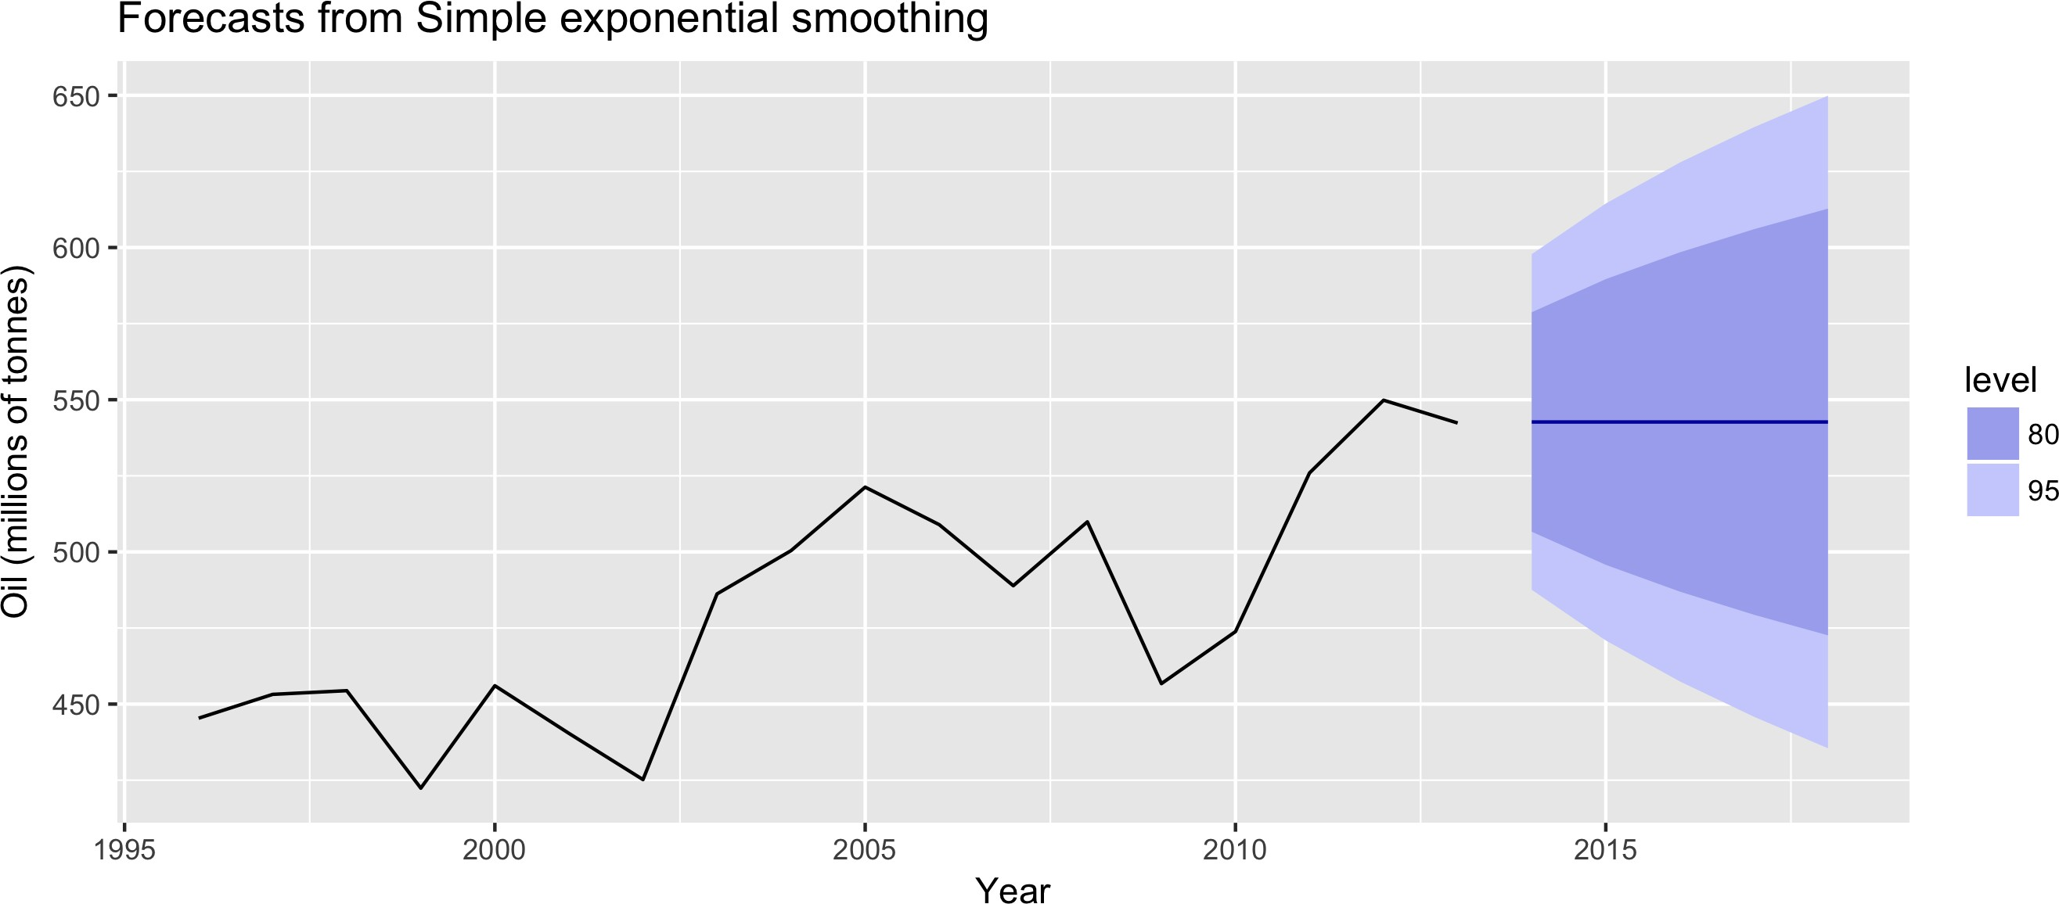
EXAMPLE OIL PRODUCTION
autoplot(fc) +
ylab("Oil (millions of tonnes)") + xlab("Year")

Slide 12
Let's practice! F O R EC AS T I N G I N R

Slide 13
Exponential Smoothing Methods With Trend F O R EC AS T I N G I N R
Zahid Asghar
Professor School of Economics, QAU

Slide 14
HOLT'S LINEAER TREND
 | Simple exponential smoothing
Forecast | y^t+h∣t = ℓt
Level | ℓ_{t} = αy_{t} + (1 − α)ℓ_{t−1}
 | Holt's linear trend
Forecast | y^_{t+h∣t} = ℓ_{t} + hb_{t}
Level | ℓ_{t} = αy_{t} + (1 − α)(ℓ_{t−1} + b_{t−1})
Trend | b_{t} = β∗(ℓ_{t} = ℓ_{t−1}) + (1 − β∗)b_{t−1}

Slide 15
HOLT'S LINEAER TREND
 | Holt's linear trend
Forecast | y^_{t+h∣t} = ℓ_{t} + hb_{t}
Level | ℓ_{t} = αy_{t} + (1 − α)(ℓ_{t−1} + b_{t−1})
Trend | b_{t} = β∗(ℓ_{t} = ℓ_{t−1}) + (1 − β∗)b_{t−1}
Two smoothing parameters α and β∗ where 0 ≤ α and
β∗ ≤ 1
Choose α, β∗, ℓ₀, b₀ to minimize SSE

Slide 16
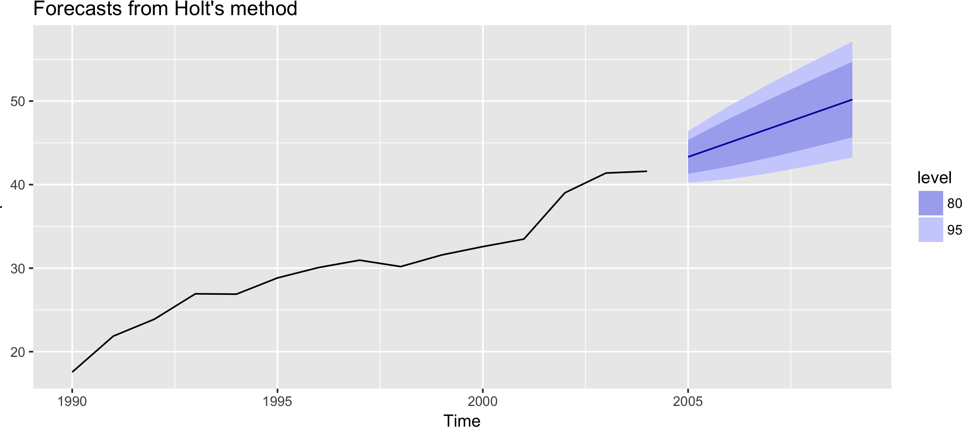
HOLT'S METHOD IN R
airpassengers %>% holt(h = 5) %>% autoplot

Slide 17
DAMPED TREND METHOD
Component form
y^_{t+h∣t} = ℓ_{t} + (ϕ + ϕ² + ... + ϕ^{h})b_{t}
ℓ_{t} = αy_{t} + (1 − α)(ℓ_{t−1} + ϕb_{t−1})
b_{t} = β∗(ℓ_{t} = ℓ_{t−1}) + (1 − β∗)ϕb_{t−1}
Damping parameter 0 < ϕ < 1
If ϕ = 1, identical to Holt's linear trend
Short-run forecasts trended, long-run forecasts constant

Slide 18
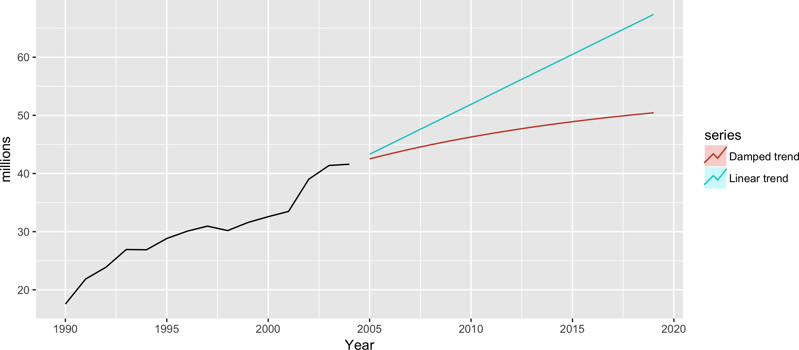
EXAMPLE : AIR PASSENGERS
fc1 <- holt(airpassengers, h = 15, PI = FALSE)
fc2 <- holt(airpassengers, damped = TRUE, h = 15, PI = FALSE) autoplot(airpassengers) + xlab("Year") + ylab("millions") +
autolayer(fc1, series="Linear trend") + autolayer(fc2, series="Damped trend")

Slide 19
Let's practice! F O R EC AS T I N G I N R

Slide 20
Exponential Smoothing Methods With Trend And Seasonality F O R EC AS T I N G I N R
Zahid Asghar
Professor School of Economics, QAU

Slide 21
HOLT-WINTERS' ADDITIVE METHOD
Holt-Winters additive method
y^t+h∣t = ℓt + hbt + st−m+h⁺ m
ℓ_{t} = α(y_{t} − s_{t−m}) + (1 − α)(ℓ_{t−1} + b_{t−1})
b_{t} = β∗(ℓ_{t} = ℓ_{t−1}) + (1 − β∗)b_{t−1}
s_{t} = γ(y_{t} − ℓ_{t−1} − b_{t−1}) + (1 − γ)s_{t−m}
st−m+h⁺
= seasonal component from nal year of data
Smoothing parameters:
0 ≤ α ≤ 1, 0 ≤ β∗ ≤ 1, 0 ≤ γ ≤ 1 − α
m = period of seasonality (e.g. m = 4 for quarterly data) Seasonal component averages zero

Slide 22
HOLT-WINTERS' MULTIPLICATIVE METHOD
Holt-Winters multiplicative method
y^t+h∣t = (ℓt + hbt)st−m+h⁺ m
ℓ_{t} = α( ^{yt} ) + (1 − α)(ℓ_{t−1} + b_{t−1}) st−m
b_{t} = β∗(ℓ_{t} = ℓ_{t−1}) + (1 − β∗)b_{t−1}
s_{t} = γ ^{yt} + (1 − γ)s_{t−m} ℓt−1 −bt−1
Seasonal component averages one

Slide 23
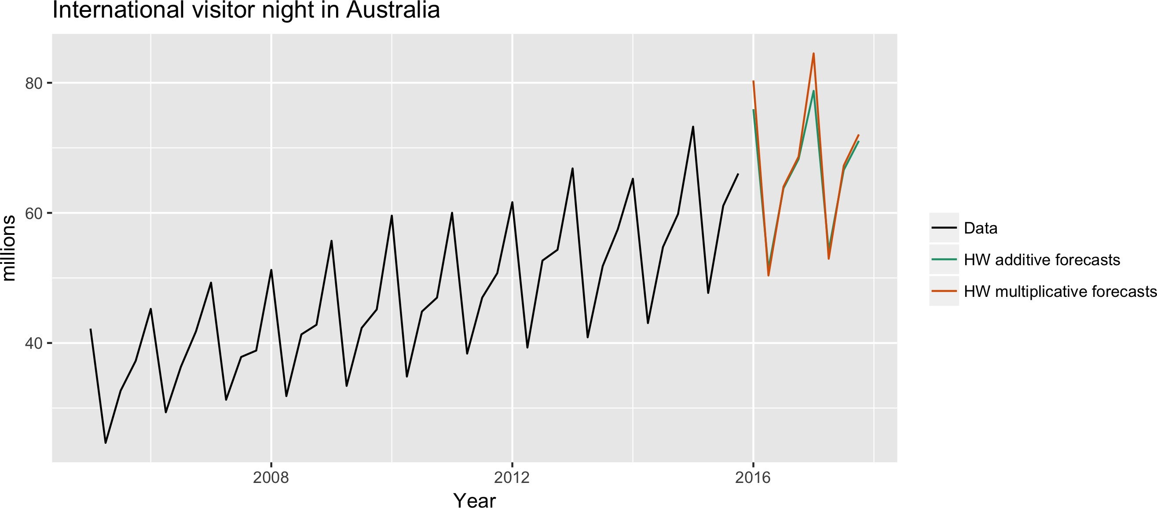
EXAMPLE : VISITOR NIGHTS
aust | <- | window(austourists, | start = 2005)
fc1 | <- | hw(aust, seasonal = | "additive")
fc2 | <- | hw(aust, seasonal = | "multiplicative")

Slide 24
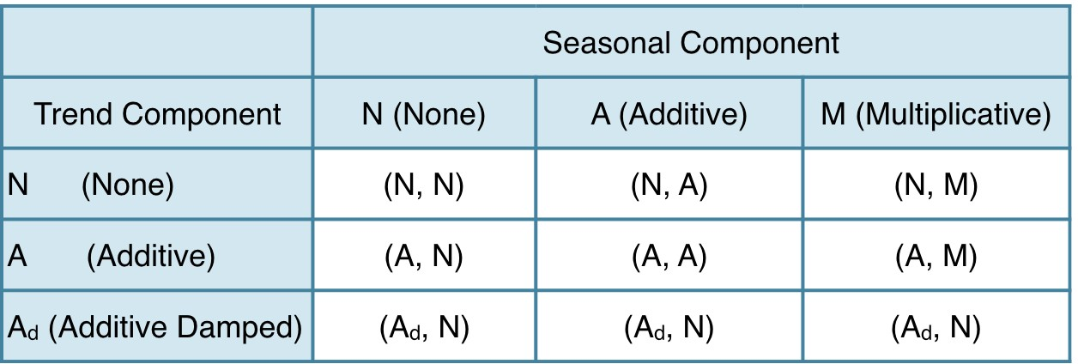
TAXONOMY OF EXPONENTIAL SMOOTHING METHODS

Slide 25
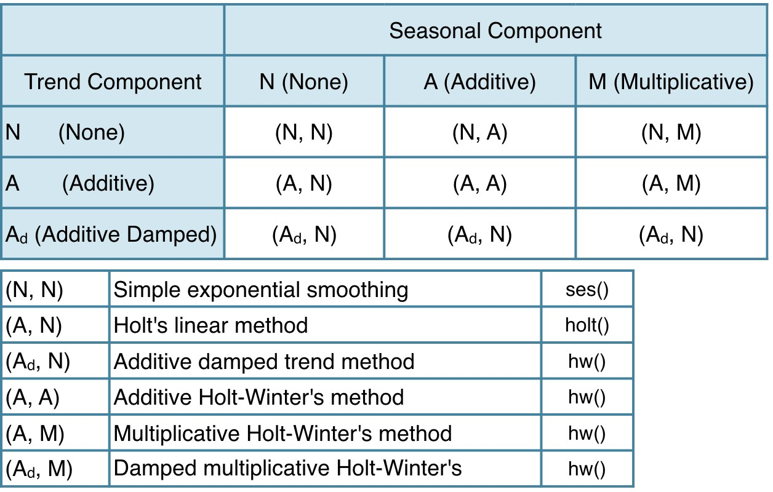
TAXONOMY OF EXPONENTIAL SMOOTHING METHODS

Slide 26
Let's practice! F O R EC AS T I N G I N R

Slide 27
State Space Models For Exponential Smoothing F O R EC AS T I N G I N R
Zahid Asghar
Professor School of Economics, QAU

Slide 28

I NNOVATIONS STATE SPACE MODELS Each exponential smoothing method can be wri en as an "innovations state space model"

Slide 29
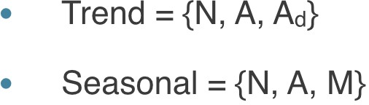
I NNOVATIONS STATE SPACE MODELS Each exponential smoothing method can be wri en as an "innovations state space model"

Slide 30
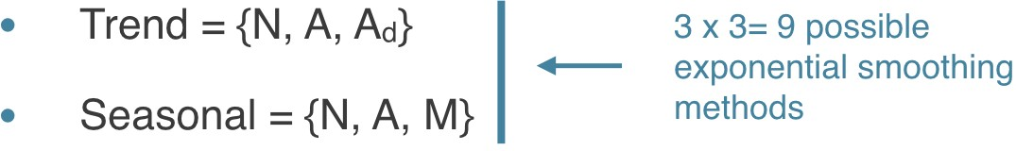
I NNOVATIONS STATE SPACE MODELS Each exponential smoothing method can be wri en as an "innovations state space model"

Slide 31
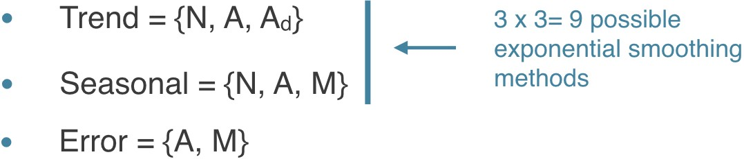
I NNOVATIONS STATE SPACE MODELS Each exponential smoothing method can be wri en as an "innovations state space model"

Slide 32
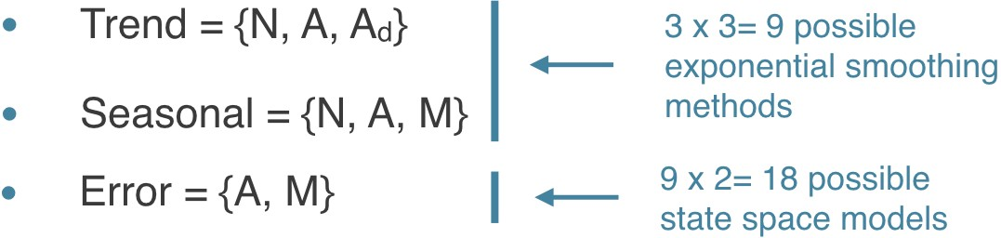
I NNOVATIONS STATE SPACE MODELS Each exponential smoothing method can be wri en as an "innovations state space model"
ETS models: Error, Trend, Seasonal

Slide 33
ETS MODELS
Parameters: estimated using the "likelihood", the probability of the data arising from the speci ed model
For models with additive errors, this is equivalent to minimizing SSE
Choose the best model by minimizing a corrected version of Akaike's Information Criterion (AIC_{c})

Slide 34
EXAMPLE : AUSTRALIAN AIR TRAFFIC
ets(ausair)
ETS(M,A,N)
Call:
ets(y = ausair) Smoothing parameters:
alpha = 0.9999
beta = 0.0176 Initial states:
l = 6.5242
b = 0.7584
sigma:
AIC
0.0729
AICc BIC
234.5273 236.0273 243.6705

Slide 35
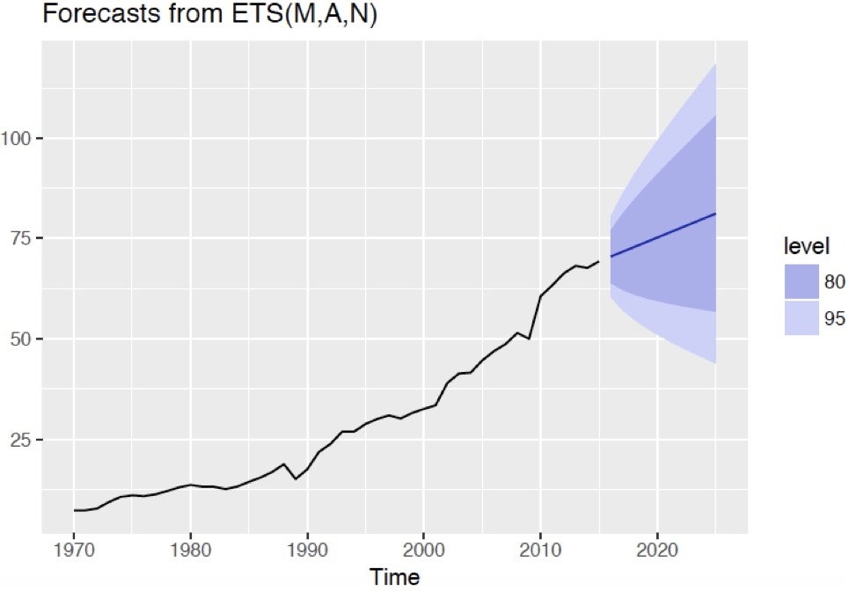
EXAMPLE : AUSTRALIAN AIR TRAFFIC
ausair %>% ets() %>% forecast() %>% autoplot()

Slide 36
EXAMPLE: MONTHLY CORTECOSTEROID DRUG SALES
ets(h02)
ETS(M,Ad,M)
Call:
ets(y = h02) Smoothing parameters:
alpha = 0.2173 beta = 2e-04 gamma = 1e-04 phi = 0.9756
Initial states: l = 0.3996
b = 0.0098
s=0.8675 0.8259 0.7591 0.7748 0.6945 1.2838
1.3366 1.1753 1.1545 1.0968 1.0482 0.983
sigma: 0.0647
AIC AICc
BIC
-63.49289
-123.21905 -119.52175

Slide 37
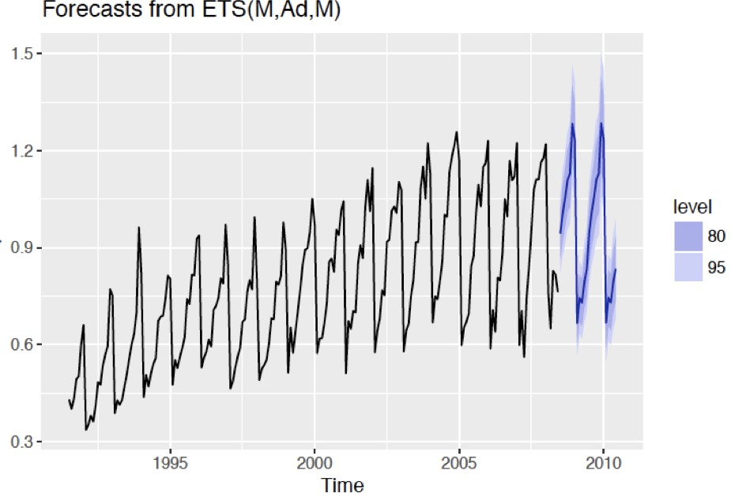
EXAMPLE: MONTHLY CORTECOSTEROID DRUG SALES
h02 %>% ets() %>% forecast() %>% autoplot()

Slide 38
Let's practice! F O R EC AS T I N G I N R

